Slide 1
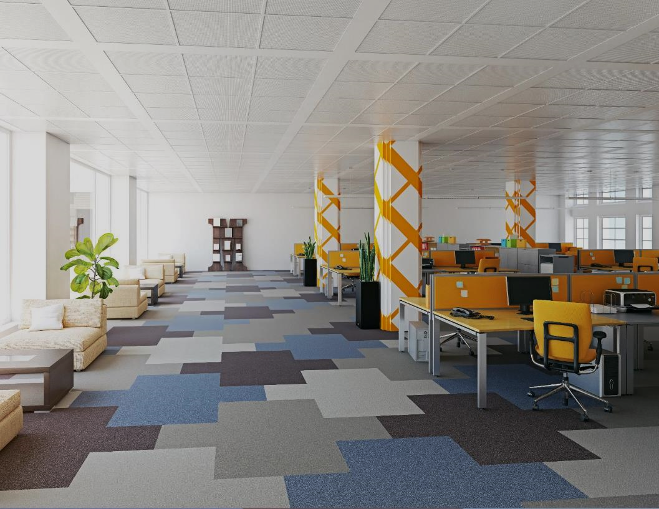


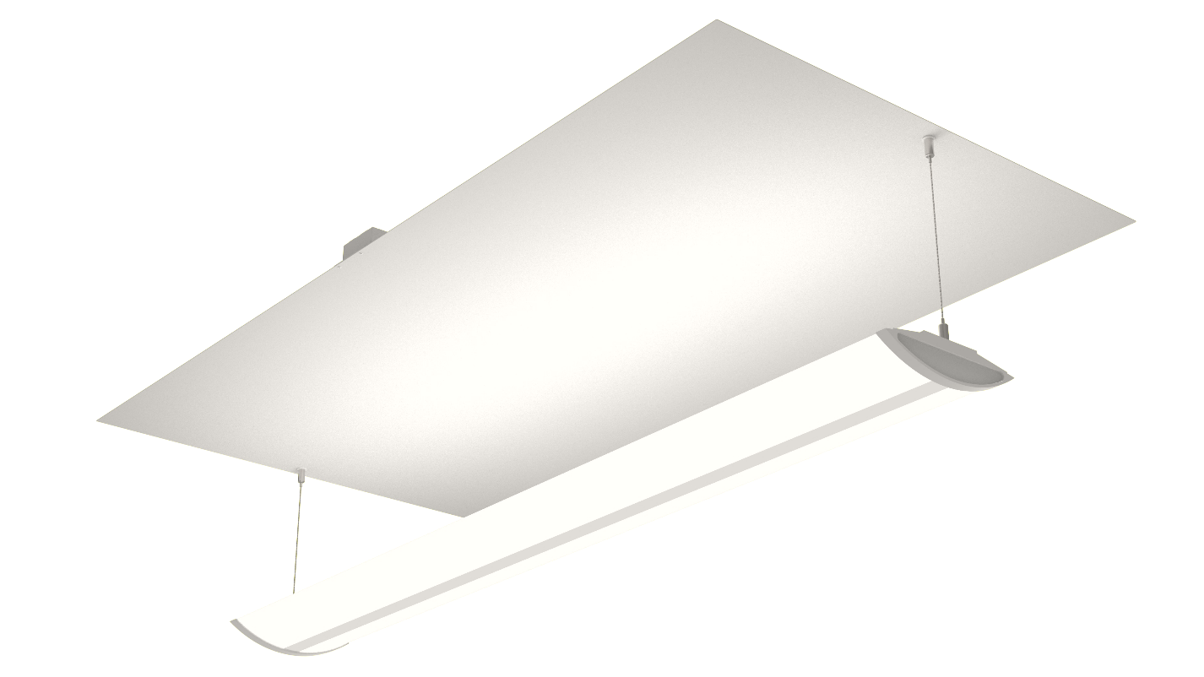
Low Glare Light Shaping Optical Film.
Fits Like A Troffer, Hangs Like A Pendant

Slide 2

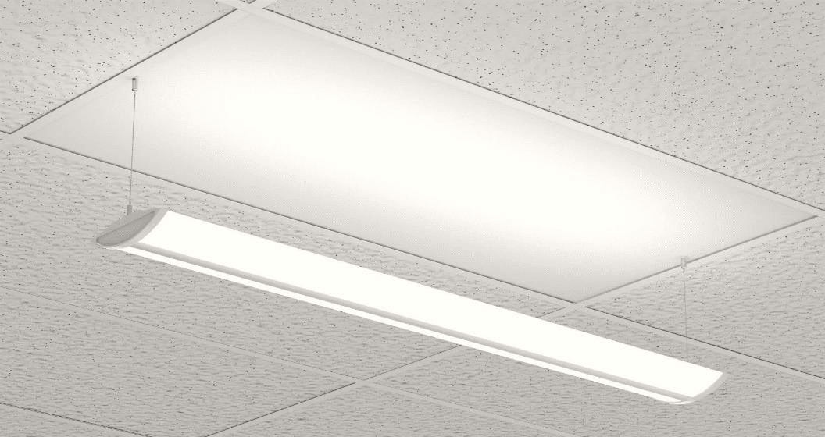

the brightest light is dimmed
and partially reflected backwards
light shaping optical film layers direct
soft diffused light evenly to the work plane
back scattered up-light is evenly diffused on
the panel to give your room a soft open feel
high angle light has a soft cutoff that reduces glare

Slide 3
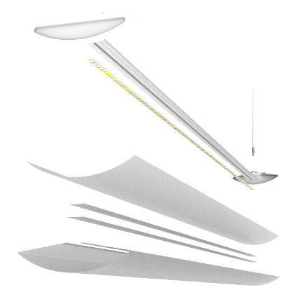
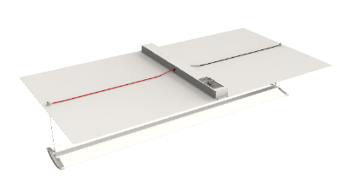
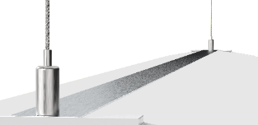
Advanced Thermal Protection:
Aluminum heat sink is exposed to
circulating room air for long LED life
Light Shaping Diffuser Film
Overlay: Further condenses the light
Center Strips: Reflects and diffuses the bright areas of the LED strip
Outer Shell: Condenses and diffuses both the up and down light
Aluminum Powder Coated Panel:
Fits in the ceiling grid like any troffer
Powered Wire Rope:
Just insert each wire end into the grippers and you’re done. Saves on installation time

Slide 4

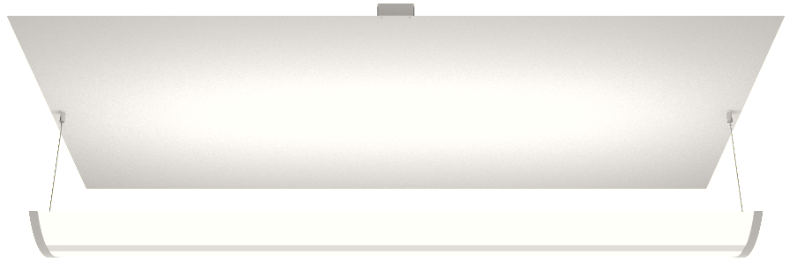

Features & Specifications
Description
A 1.5” depth light engine features 4 layers of light shaping diffusion film providing soft low glare illumination with 50% up-light. The light engine quickly connects to a troffer style aluminum ceiling grid panel with low voltage powered wire rope. The textured powder coat paint evenly diffuses the soft up-light, creating a pleasing volumetric effect.
Optics
1.5” depth light engine includes 4 layers of light shaping diffusion film
Fully diffused low glare optics provide unprecedented efficacy up to 142 lm/w
50% up-light or option for no up-light
Light engine mounted to main panel with powered wire rope.
Applications
For new construction or remodel with suspended ceilings
Options
Master/Satellite wiring certified
Emergency battery backup
Whips available
Construction
Ultra-shallow light engine depth of 1.75” with sealed lens system design for maintenance free fixture life
.032” aluminum base panel with textured powder coat
Aluminum heat sink cooled by circulating room air for long LED life
Rated Life
66,000+ hours L70 TM-21
Electrical
Light engine powered with low voltage through wire rope
Quick connect gripper attachments
100-277V standard
Optional 347V LED driver
Standard 0-10v dimming
Multiple driver upgrade options
5-year limited warranty includes all components
Installation
Panel drops into ceiling grid
Standard electrical connections
Light engine installs last with powered wire rope with gripper quick connects
Size Options
Standard 2’x2’ and 2’x4’
Available in custom sizes
MADE IN CANADA

Slide 5

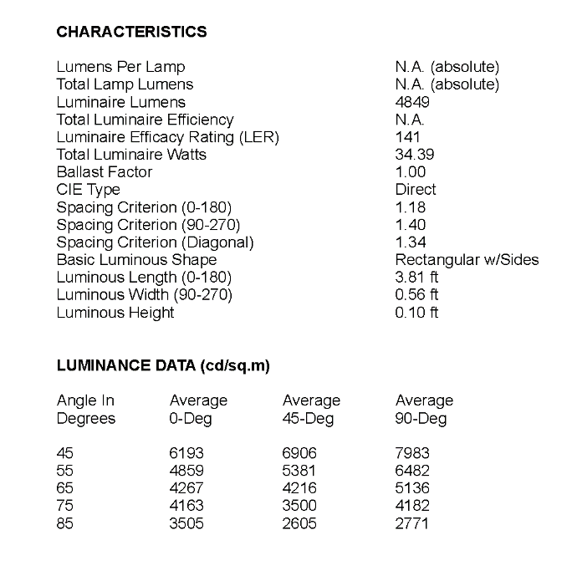
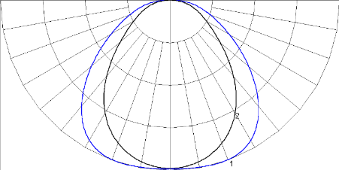
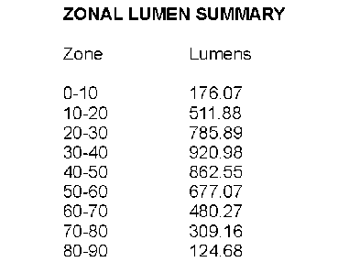
Photometry
Fixture: DM-V-24-48-36W-I-50L-CT41-D-120-X CCT: 4100K Lumens: 4849 Efficacy: 141 lm/w CRI: 83 (no up-light)

Slide 6



ORDERING GUIDE
FEATURES CODE OPTIONS DESCRIPTION
Model
DM-V Dimensions
Width
12 12”
24 24”
Length
24 24”
48 48”
Wattage
XXW See Model Chart For Wattage
Driver
Mounting
I Integral
Nominal
Lumens
32L 3200 lm
42L 4200 lm
50L 5000 lm
Canadian Sales:
cdnsales@illumisoftlighting.com
888-441-0555 Press #1
CCT
CT35 3500k
CT41 4100k
USA Sales:
brett@illumisoftlighting.com
613-851-3660
Control
D Standard Dim (0-10V, PWM, Trim Pot)
Voltage
120 100 – 277 V
347 100 - 347 V
Illumisoft Lighting Canada Ltd.
160 Spruce St. Ottawa ON K1R 1C6 Canada
Options
X No Options
EBB Emergency Battery Backup
MS Master/Satellite Wiring
Copyright © 2019 Illumisoft Lighting Canada Ltd. All rights reserved. Please refer to online specifications for the most up-to-date content as specifications are subject to change without notice.

